Slide 1
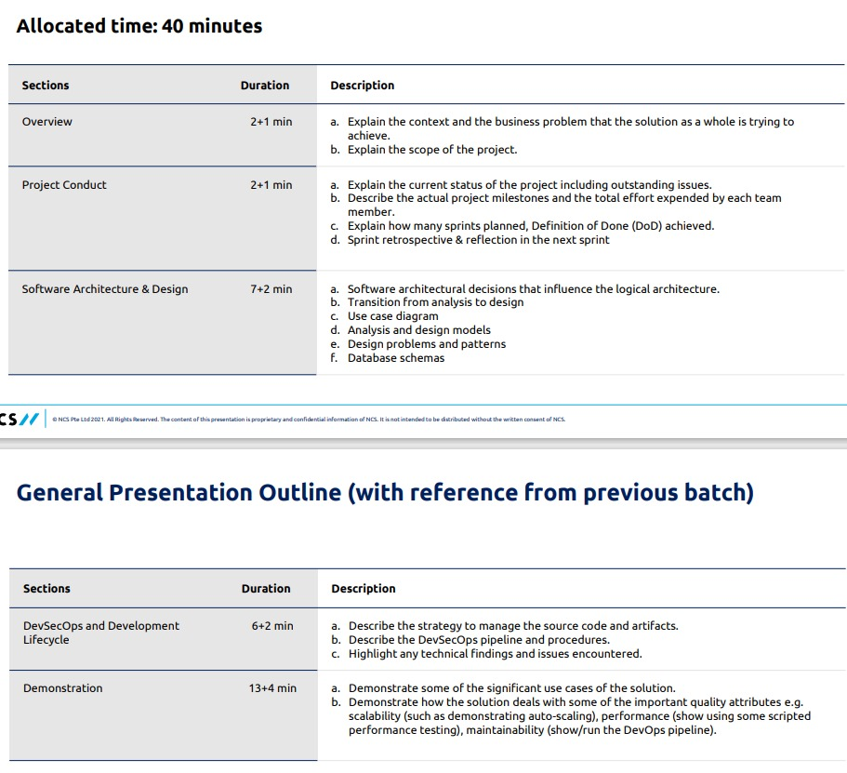

Slide 2
StayMate
Hotel Booking Platform
Team 5:
Phillip Chen, Jonathan Lim, Lee Jun Heng, Ng Ju Khang, Ng Zhi Kai
NUS-ISS
Graduate Certificate Practice Project - Designing Modern Software Systems

Slide 3
AGENDA
01
Overview
02
Project Conduct
03
Software Architecture & Design
04
DevSecOps & Development Lifecycle
05
Performance Testing
06
Demo

Slide 4
Project Title: StayMate Hotel Booking Platform
Purpose:
To design, develop, and deploy a full-stack hotel booking platform supporting user authentication, hotel browsing, booking management, and administrative controls.
Project Overview - Purpose

Slide 5
Project Overview - Scope
User Management
Hotel Services
01
02
Features include user registration, login, and profile management to ensure personalized user experience.
Users can search, browse, find nearby hotels, book rooms, read reviews, and make payments seamlessly.
Email Notification
Admin Management
03
Automated email notifications are sent for user verification to enhance security and communication.
04
Admin accounts are provided for effective management and oversight of the platform.
Notes:
Scope:
User registration, login and profile management
Hotel search, browse, nearby, booking, reviews and payment
Email notification service for user verification
Admin account for management

Slide 6
Project Overview - Technology Stack
Layer | Technologies
Frontend | React.js, Tailwind CSS
Backend | Java, Spring Boot
Database | AWS RDS (MySQL)
Hosting | GitHub Pages (frontend), AWS EC2 (backend)
Integration | SMTP Email Service
Tools | JMeter for performance testing GitHub for source control

Slide 7
Project Conduct

Slide 8
The StayMate Hotel Booking Platform has reached its initial production-ready milestone, with core features successfully implemented, tested, and deployed. These include:
User Registration and Authentication
Enables users to sign up, log in, and manage their accounts.
Hotel and Room Browsing
Provides hotel and room information with support for search.
Booking Management
Allows users to create, view, and manage bookings with a streamlined workflow.
Email Integration
Sends verification emails to users to confirm registration status.
Notifications
Automatically sends confirmation messages for key actions such as booking creation.
Project Conduct - Current Status

Slide 9
Project Conduct - Outstanding Issues
Error Handling
Some edge cases require more robust error handling to improve reliability and user experience.
Test Coverage
Additional testing is planned, particularly for integration scenarios and complex edge cases.
Security Enhancements
To strengthen the system’s safety by adding access limits, securing the website, and better protecting important information.
Mobile Optimization
Functional but requires further optimization and QA across a broader range of devices.
Notes:
Error Handling
Some edge cases require more robust error handling to improve reliability and user experience.
Test Coverage
Additional testing is planned, particularly for integration scenarios and complex edge cases.
Security Enhancements
Future updates will address rate limiting, SSL certificate integration, and secure secrets management for production environments.
Mobile Optimization
While mobile responsiveness is functional, further optimization and QA across a broader range of devices is planned.

Slide 10
Project Conduct - Milestones
01
03
05
02
04
Stable Backend
Integration
Sprint 3
Sprint 5
Developed backend, setup database
Integration of frontend to backend
We are here
Design System
Working Frontend
CICD Pipeline
Sprint 1
Sprint 4
Sprint 6
Requirements gathering, finalize details and design
Creation of frontend pages
Setting up of the CICD pipeline and deployment to GitHub pages / AWS

Slide 11
Project Conduct - Effort Expended
Team Member | Effort (Man-hours) | Key Contributions
Zhi Kai | 200 | Backend development, Frontend development, API integration, CI/CD setup, deployment, system design, testing
Ju Khang | 100 | Requirements gathering, Frontend development, System design, System Testing, Performance Testing
Jonathan | 80 | Enhancement of functionality with testing. Fixing of bugs. Frontend development.
Jun Heng | 100 | Setting up of project, frontend development, enhancement of functionality with testing, fixing of bugs.
Phillip | 80 | Integrating testing framework, system testing, writing unit testing for API.

Slide 12
Project Conduct - Sprints Planned (2 weeks per sprint)
v
01
Project Setup & Initial Design
Set up project repositories, communication channels, project plan, define architecture, prepare database schema.
02
Project Setup & Initial Design
Continue with system analysis and design, including of frontend and backend initial setup
03
Development Sprint
Begin development for both frontend and backend
04
Development Sprint
Continue development for both frontend and backend, with updated sprint backlog
05
Integration
Integrating frontend with backend, and other services such as email service
06
Deployment Setup
Setup CI/CD pipeline with GitHub Actions, and setup frontend deployment on GitHub pages, and backend deployment on AWS EC2 instance

Slide 13
Project Conduct - Definition of Done (DoD)
Code
Deployment Readiness
Code reviewed and merged without conflicts
Testing
Frontend and Backend integrated successfully
Environment configurations completed
Ready for production deployment
Documentation
Unit, Integration, and system tests passed
Feature meets all acceptance criteria
No critical or major bugs
User guides updated
Notes:
🔹 Code Quality "All code changes are peer-reviewed, approved, and merged cleanly without conflicts."
🔹 Testing "All tests pass successfully, and the feature meets the agreed acceptance criteria with no major bugs."
🔹 Deployment Readiness "Frontend and backend are fully integrated, configured, and ready for seamless production deployment."
🔹 Documentation "Relevant user guides and documentation are updated to reflect the latest changes."

Slide 14
Project Conduct - Sprint Retrospective & Reflection
Sprints | What Went Well | What Could be Improved
Sprint 1-2 | Project setup and planning were smooth, with a clear architecture and database schema established early | Setup could have been completed earlier to give more time for development
Sprint 3-4 | Development progressed across frontend and backend. | Improve team communication and clarification of requirements early in each sprint to avoid misunderstandings and reduce duplicated effort
Sprint 5 | Integration efforts were successful, most APIs and services worked as expected. | Improve earlier alignment between frontend and backend teams to reduce last-minute integration issues
Sprint 6 | CI/CD and deployment were set up with minimal issues, making final deployment smoother than expected | Document the deployment process more clearly to make future deployments smoother

Slide 15
Software Architecture & Design

Slide 16
Software Architecture Overview
Architecture Style: Layered (Client → Web → Service → Repository → Database)
Frontend: React + TypeScript
Backend: Spring Boot (Java)
Database: MySQL (Relational, normalized)
Patterns Applied:
State (Room availability)
Strategy (Payments, Notifications)
Factory (Room creation)
Observer (Event-driven notifications)
Key Modules:
User Service – authentication, registration, role-based access
Hotel Service – CRUD for hotels, room assignment
Booking Service – manage booking lifecycle
Payment Service – integration with payment gateways
Notification Service – real-time updates via Observer pattern

Slide 17
Transition from Analysis to Design
Strategy | Description
Use Case → Sequence Diagrams | Derived sequence diagrams from key use cases (e.g., Book Hotel, Manage Accounts) to define system interactions and identify necessary services and controllers.
Domain Model Mapping | Designed core domain entities (User, Room, Booking) based on business logic, then aligned them with the database schema.
Layered Architecture | Mapped system behavior into Presentation → Service → Repository layers to enforce separation of concerns.

Slide 18
Transition from Analysis to Design
Strategy | Description
Controller-Service-Repository | Structured backend into clear layers for routing, business logic, and persistence; mapped to HTTP and DB flows.
Design Patterns | Applied patterns (State, Strategy, Factory, Observer) to solve behavioral and structural challenges.
Traceability Matrix | Maintained alignment between user stories, UI components, backend methods, and test cases.
API Contract (Swagger) | Defined OpenAPI specs for consistent frontend-backend integration (e.g., Book Room, Login).

Slide 19
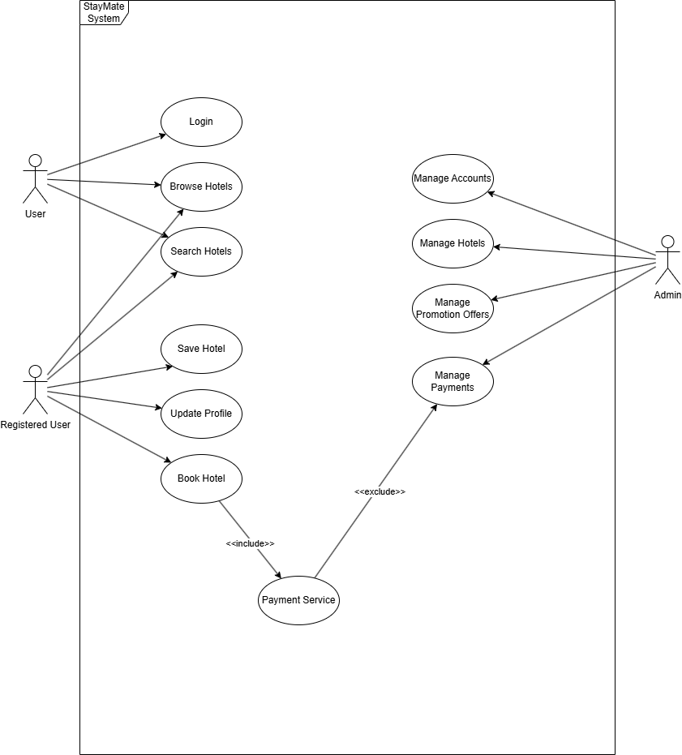
Use Case Diagram
Actors
Admin
User
Registered User
Use Cases
Login
Browse Hotels
Search Hotels
Save Hotels
Update Profile
Book Hotel
Manage Accounts (Admin)
Manage Hotels (Admin)
Manage Promotional Offers (Admin)
Manage Payments (Admin)
Payment Service
Notes:
The use case diagram outlines interactions between three main actors—User, Registered User, and Admin—with core system functionalities such as browsing, booking, managing of accounts and hotel management.

Slide 20
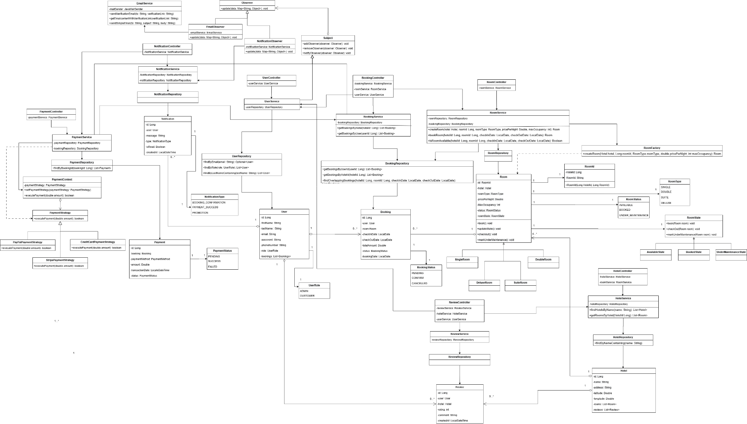
Class Diagram
Illustrates system structure: key classes and relationships.
Example classes: User, Hotel, Room, Booking, Payment, Notification.
Composite keys and associations (e.g., a Booking links a User and a Room).

Slide 21
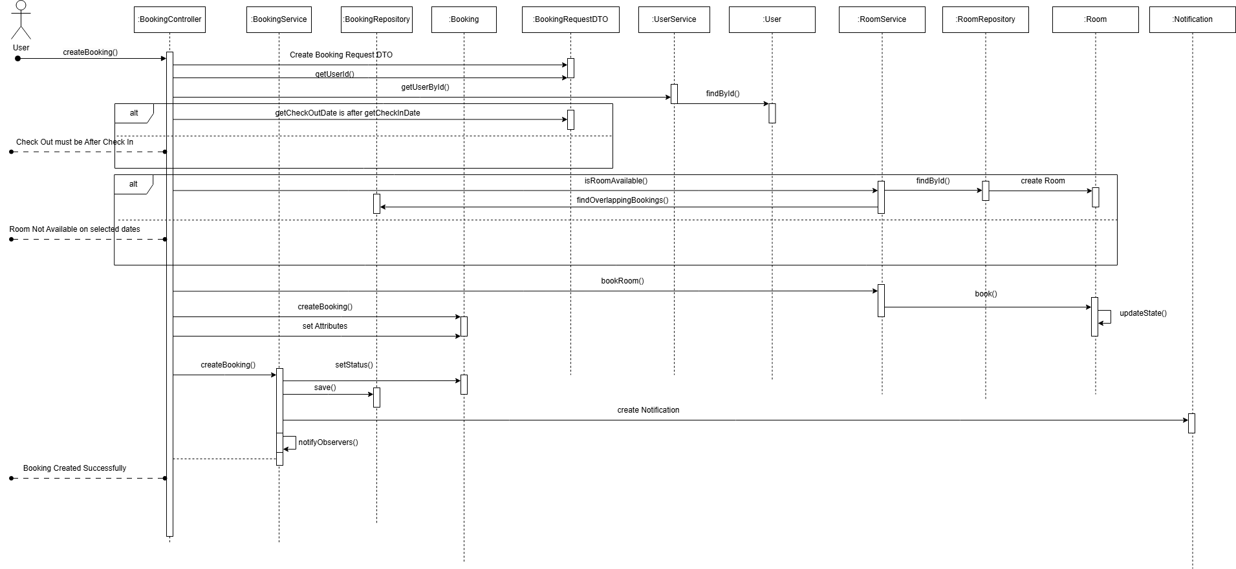
Sequence Diagrams
CREATE HOTEL BOOKING
Notes:
Sequence Diagram – Booking Flow
Use Case: User initiates a hotel room booking request via createBooking().
Flow Highlights:
Validation Steps:
Checks if checkout date is after check-in date.
Verifies room availability by checking for overlapping bookings.
Entity Interactions:
Retrieves user and room details via UserService and RoomService.
Creates and persists a new Booking entity.
Updates room state upon successful booking.
Triggers observer pattern to send notifications post-booking.
Architecture Layers Involved:
Controller: Handles request entry.
Service Layer: Coordinates logic and validations.
Repository: Handles persistence.
Domain Model: Booking and Room entities encapsulate core behavior.

Slide 22
Design Problems & Patterns
Problem | Pattern Solution
Room behavior changes by state | State Pattern: Encapsulates logic in AvailableState, BookedState, etc
Extensible payment methods (Card, PayPal, etc.) | Strategy Pattern: Enables dynamic selection of payment behavior
Consistent room object creation logic | Observer Pattern: Decouples notification logic from booking flow
Real-time user notifications | Observer Pattern: Decouples notification logic from booking flow

Slide 23
Database Schema
Table | Purpose | Key Fields
Users | Stores user information and roles (Customer/Admin) | id, email, role, verified
Hotel | Stores hotel details like name and location | id, name, address, latitude, longitude
Room | Stores room information for each hotel | hotel_id, room_id, room_type, price_per_night
Booking | Manages hotel room bookings by users | id, user_id, hotel_id, room_id, status
Review | Stores user ratings and comments for hotels | id, user_id, hotel_id, rating, comment
Payment | Records payments for hotel bookings | id, booking_id, payment_method, status
Notification | Sends booking, payment, and promo notifications to users | id, user_id, message, type, is_read
Bookmark | Links users to their saved hotels | user_id, hotel_id
Notes:
Our database is designed with clear separation of responsibilities across eight main tables. Users and hotels are the core entities, along with rooms, bookings, reviews, and payments to manage the different interactions between them. Notifications and bookmarks further enhance user experience by providing updates and allowing hotel saving features. We also use foreign keys and enums to maintain data integrity and consistency across the system, to ensure that operations like booking, reviewing, and payment are properly linked and tracked

Slide 24
DevSecOps & Development Lifecycle

Slide 25

Source Code Management
Repository Structure
/frontend: React frontend code
/backend: Spring Boot backend services
/docs: Project documents & API specs
/scripts: Deployment & utility scripts
GitHub
Notes:
For our project repository, we are using github to store our project codes.
We split our files into 4 different folders, frontend and backend are to their separate folders, another folder for documents such as diagrams or reports, and lastly a folder to store any scripts we have, such as creation of database schema and performance test script.

Slide 26
Source Code Management
Branching Strategy
Master Branch: Always stable & production-ready
Feature Branches:
Naming: feature/<username-develop>
Based on master, used for isolated development
GitHub
Notes:
For our branching strategy, we have a master branch, which will always have the latest working and stable copy, then each dev will create their own feature branch following the naming convention feature/name_of_dev

Slide 27
Source Code Management
Workflow
Pull latest master before development
Open Pull Requests for every change
Peer code review required before merging
Automated tests must pass
Developers handle conflict resolution locally
GitHub
Notes:
Here is how we manage our work on GitHub.
Before we start any development on our branch, we make sure to pull from the latest master branch first to stay in sync and reduce conflicts when merging.
After we are done and ready to merge, we will go through a pull request, which will be then reviewed by at least 1 teammate, to ensure peer validation.
Automated tests must also be passed before the pull request can be merged.
If there are any conflicts, the developer submitting the request should resolve before submitting.

Slide 28

DevSecOps Pipeline
Continuous Integration
Developer Workflow
👨‍💻 Push to Feature Branch ➔ Trigger CI pipeline.
🔀 Create Pull Request ➔ Code review + automatic validation.
After Deployment
🧪 End-to-End Testing: Validates major flows (Login, Hotel Booking, Payment) automatically.
GitHub Actions
Notes:
For continuous integration, when a branch is pushed, the code should have been reviewed and also validated by the automated tests, the CI pipeline then kicks in to help validate and build. After it is completed, we can then proceed to do our end to end testing on the application.

Slide 29
DevSecOps Pipeline
Continuous Deployment
Deployment Workflow
🔔 Trigger: PR merged into master branch ➔ Pipeline auto-triggered.
Every merge to master ensures the latest tested code is built, packaged, and deployed automatically.
Minimal manual intervention required ➔ Faster, safer releases! 🚀
GitHub Actions
Notes:
Similarly, after the branch merged successfully, our deployment pipeline comes in automatically to build, test, and then deploys automatically.
This process requires minimal to no intervention, thus enables faster releases.

Slide 30
DevSecOps Pipeline
CI/CD Summary
When Backend Changes | When Frontend Changes
✅ Run JUnit Tests | ✅ Build Frontend (Webpack/React Scripts)
✅ Build & Package with Maven | ✅ Deploy Frontend to GitHub Pages
✅ Deploy Backend to EC2
GitHub Actions
Notes:
In summary, when we push backend changes, the CI pipeline runs JUnit tests, builds it with Maven, and deploys to our EC2 server.
For frontend changes, it builds the app using React tools, and deploys to GitHub Pages.
This setup ensures that every update is tested, packaged, and deployed automatically, keeping things fast and reliable.

Slide 31
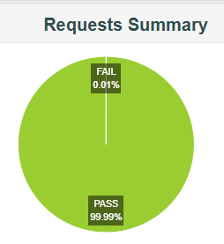

Performance Testing - Load Test
Business metrics
50
5 mins
30 mins
3 secs
No. of Virtual Users (VUs)
Ramp-Up Time Ramp-Down Time
Hold Time
Duration Assertion
Results
99.99%
57.82ms
5.25
12435
Requests handled successfully
Average Response Time
transactions/sec
Total Samples
Notes:
We conducted performance testing using JMeter to assess how well our system handles user load. Out of 12,435 simulated requests, only one failed, giving us an impressive 99.99% success rate. This shows the system is quite stable and responsive under normal load. On average, responses came back in just under 58 milliseconds, with most requests between 50 to 100 ms, even at peak. The slowest response was still under 800 ms, which is well within the acceptable limit of 3 seconds. These numbers tell us that our backend and frontend services are optimized to handle real user traffic efficiently. That one error we did see was a 400 Bad Request, likely due to a malformed payload or timing issue during ramp-up. Overall, the test results confirm that our system is ready to serve small to medium user bases reliably, with good throughput and consistent response times.

Slide 32
App Demo
https://ngzhikai.github.io/stayMate/

Slide 33
CICD Demo

Slide 34
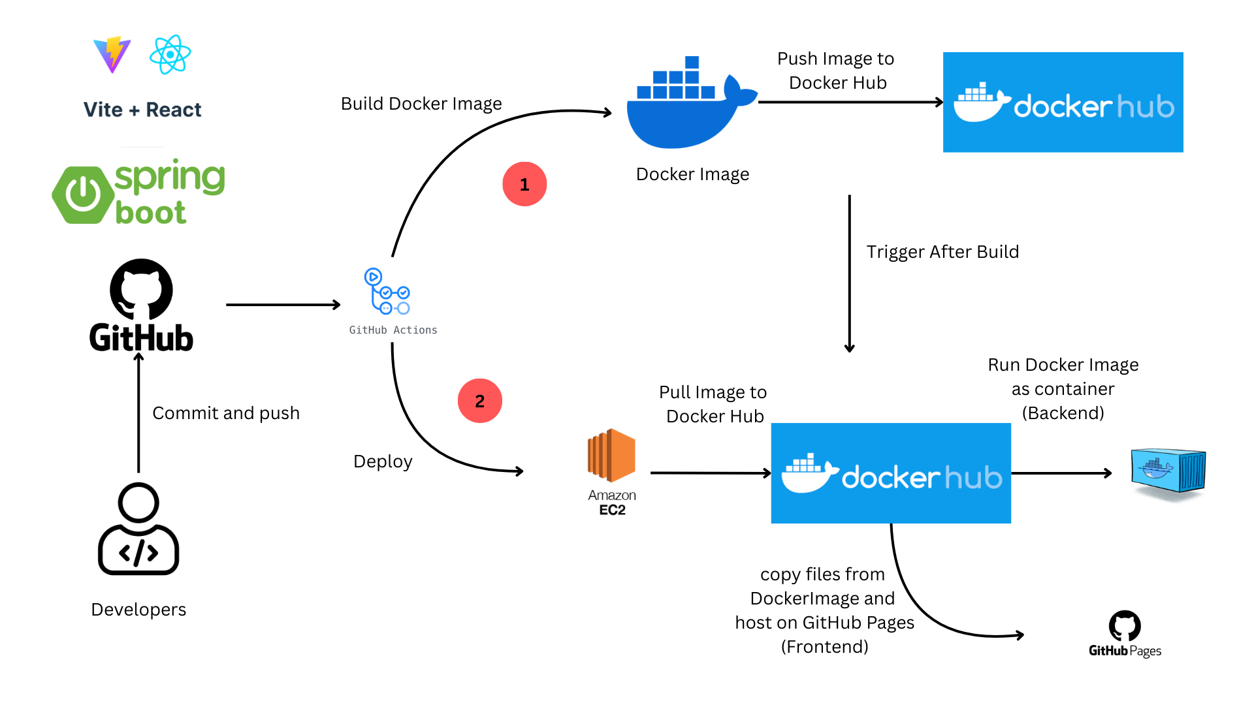
DevSecOps Pipeline

Slide 35
THANK YOU
Any questions?

